Slide 1
Quick Scheme
Rodrigo Sardiñas

Slide 2
Topics
Dr. Racket
Interactive Mode
Lambda Calculus (short)
Lists!
Variables
Procedures (lambda)
Selection (cond)
Iteration (recursive)

Slide 3
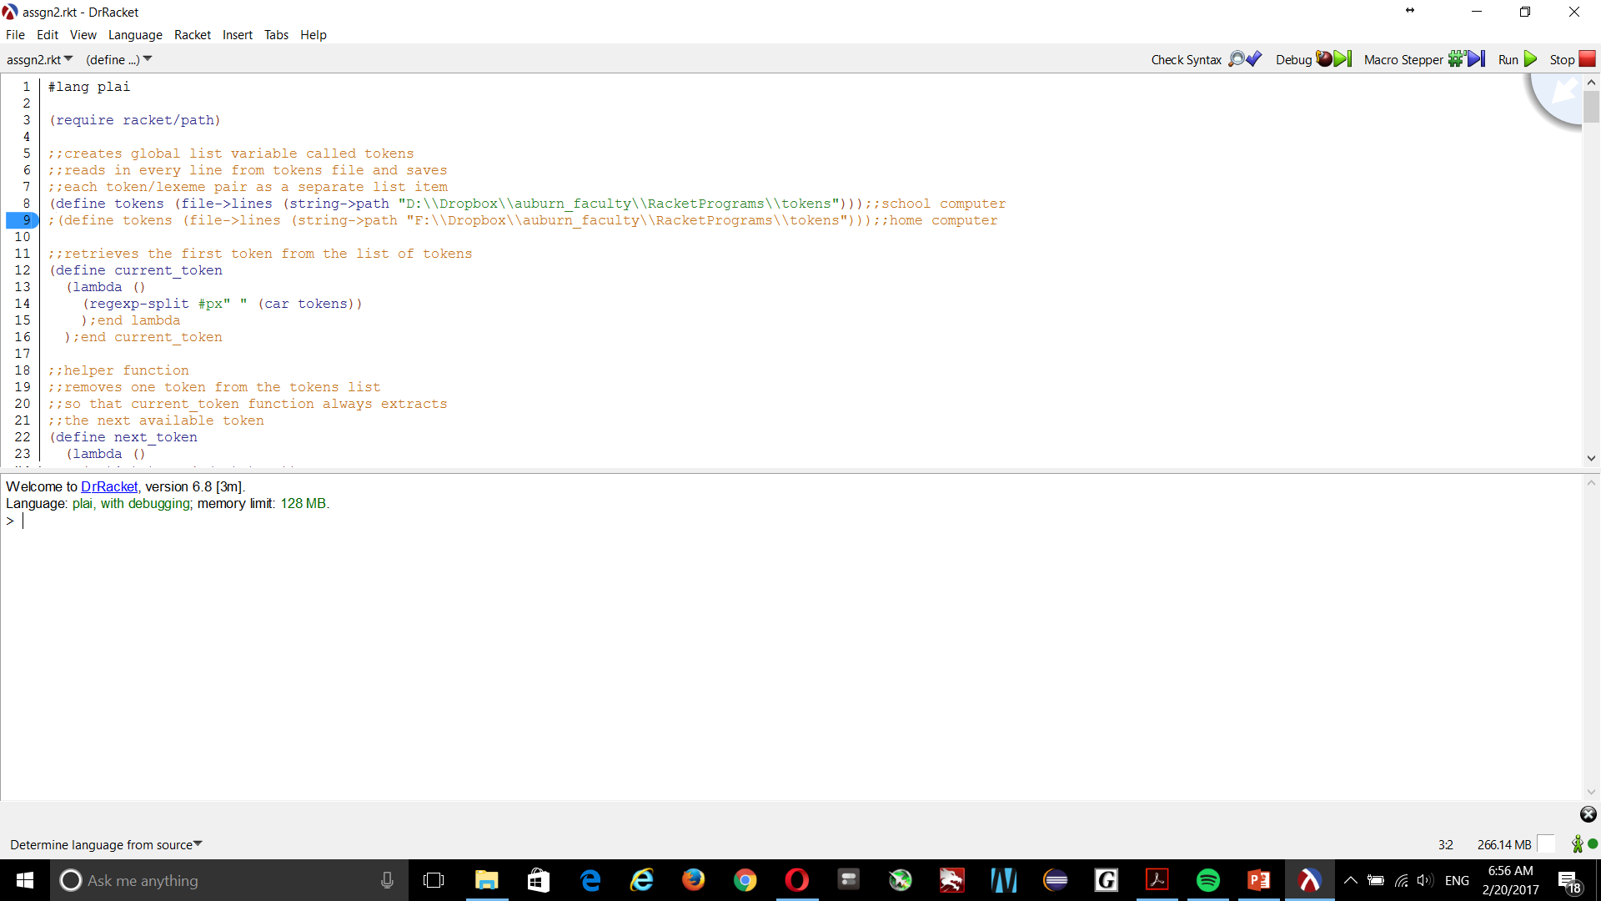
Dr. Racket (Gui Demo In-class)

Slide 4
Dr. Racket
Where to get it
https://racket-lang.org
Reference Docs
http://docs.racket-lang.org/drracket/index.html
http://docs.racket-lang.org/quick/index.html
https://docs.racket-lang.org/racket-cheat/index.html
Online Textbook
http://www.scheme.com/tspl4/

Slide 5
Dr. Racket – Interactive & Language
Use this “language”. Kind of like a library.
Run commands in file, start interactive mode.

Slide 6
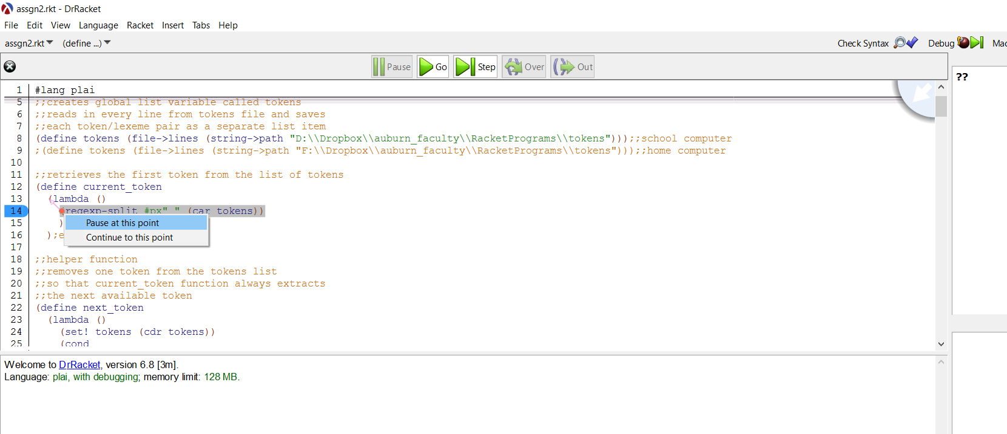
Dr. Racket - Debugging
Place Breakpoints
Start Debug Mode

Slide 7
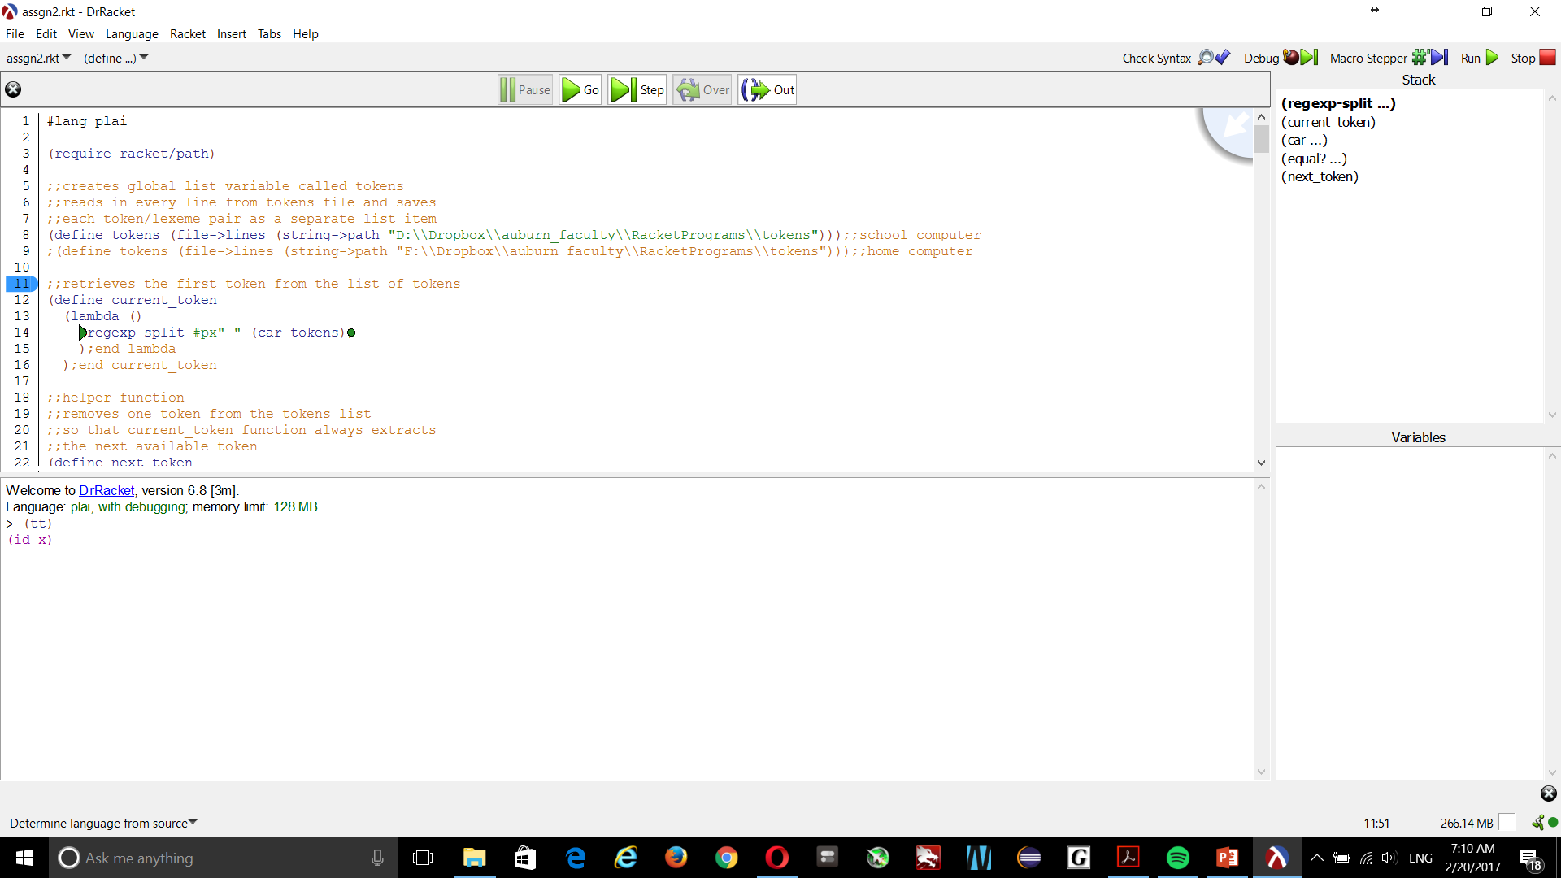
Dr. Racket - Debugging

Slide 8
Dr. Racket - Debugging
Interactive
Stack trace
Step commands

Slide 9
Lambda Calculus
Lambda calculus (also written as λ-calculus or called “the lambda calculus”) is a formal system in mathematical logic and computer science for expressing computation by way of variable binding and substitution.
Wikipedia

Slide 10
Lambda Calculus
Short, but interesting paper
Perhaps more simply put here
Alonzo Church
Smallest Universal Programming Language!
No Data types, only functions

Slide 11
Lists! It’s a function! No, it’s a variable! No… It’s a ‘(List)!
(car (first element in list))
(car ‘(A B C)) – returns ‘(A)
(cdr (everything except first item in list – the rest))
(cdr ‘(A B C)) – returns ‘(B C)
(cadr & caddr): shorthand combinations of the above
(first (first element in list; list with 1 item))
(second … tenth (nth item in list; list with 1 item))
(cons (combine two “lists”) )
(cons ‘A ‘(B C D)) – returns ‘(A B C D)
list (similar to cons, creates new lists containing elements)
(list ‘A ‘B ‘(C D) ) – returns ‘(A B (C D))

Slide 12
Lists
Given the way that scheme is implemented EVERYTHING returns something, even lists!
If a list only accepts 2 items, and you need to pass in multiple items, the 2nd item must be another list
Lists can be heterogeneous in Scheme (this extends to data & functions)
Scheme uses pre-fix notation. So the first list item is always the “root” of an expansion
Notes:
Lists simply contain symbols. Symbols can be expanded/substituted with other things (functions or data)

Slide 13
Variables - global
Even variables are defined as lists in scheme
Global (using define)
(define x 1) creates a global variable called x that is initialized to 1
First list item: define
Second list item: x
Third list item: some value, substitute this value for x
(define x (+ 1 2) ) creates a global variable called x that is initialized to 3

Slide 14
Variables – global (list items)
Even variables are defined as lists in scheme
(define x 1)
list item 1 list item 2 list item 3
sub li 1 sub li 2 sub li 3
(define x (+ 1 2) )
list item 1 list item 2 list item 3 (the whole list)

Slide 15
Variables - local
Global (using let)
(let
(x (+ 1 2))
(y (+ 2 2))
x + y) creates local variables x and y initialized to 3 and 4
By default, procedures (let is a procedure) always return the value of the last item in the list (x + y)
See link above for an example of returning last item

Slide 16
Variables - modfying
Using set!
Variables or definitions can not be “redefined” once initialized. To change the value of a definition, use the set! Keyword.
(define x 0)
(set! x 10)

Slide 17
Procedures (lambda)
Procedures (functions) are also described as lists
Using lambda
(lambda (parameters go here)
Function body goes here (as multiple lists of instructions) … see sample code on canvas
)
Used this way, lambda is a “one-time” anonymous function

Slide 18
Procedures (lambda)
Assigning a name to a lambda
Using lambda
(define x
(lambda (parameters go here, can be empty)
Function body goes here (as multiple lists of instructions) … see sample code on canvas
))
Calling x will now execute the lambda procedure associated with x

Slide 19
Procedure (define)
You can also “define” procedures
Symbols can represent data, or procedures
(x) is a procedure (a list with 1 item in it that is a procedure)
x or ‘(x) is data (a list with 1 item in it that is data – how we traditionally view a variable)

Slide 20
Procedure (define)
(define x
(display “procedure?”)
) ; will not display procedure, returns void
(define (x) ← shorthand for procedure
(display “procedure?”) ← body is rest of list items
); returns void, displays “procedure?”

Slide 21
Procedures
(define (x)
(display “procedure shorthand”))
(define x
(lambda ()
(display “Previous example converted to this”) ) )

Slide 22
Procedures
(define (x a)
(+ a a)
(display “Shorthand for below”))
(define x
(lambda (a)
(+a a)
(display “What really happens above”) ) )

Slide 23
Procedures (as lists)
1 2 1 2 3 1 2
(define (x a) (+ a a) (display “Shorthand for below”))
1 2 3 4
Lambda: 1 2 3 4
w/in lambda: 1 2 3 1 2
(define x (lambda (a) (+a a) (display “Actual”) ) )
1 2 3

Slide 24
Procedures (operators as procedures)
(define (= x y)
(if (equal? x y) #t #f)
)
(define =
(lambda (x y)
(if (equal? x y) #t #f)
) )
Notes:
Works on any type of input
We actually shadowed (re-defined or overloaded) the = procedure, by default it only compares numeric values for equality

Slide 25
Selection (cond)
Multiple ways, we will cover cond
Several benefits
Inherently handles “blocks” with multiple commands
With if statements you’d have to code a begin block
Begin blocks are implicit with the cond statement
Example on next slides

Slide 26
Selection (cond)
(cond
(
(= x 10)
(what to do if true?)
(anything else)
(more instructions?)
) ;end first equal block can have more
);end cond

Slide 27
Selection (cond)
(cond (with else)
((= x 10)
(do some stuff)) ;end first equal block
(else
(body of else goes here. Multiple ok))
);end cond

Slide 28
Selection (cond) – equivalent, required for if statement
(cond
((= x 10)
(what to do if true?)
(anything else)
) ;end first equal
);end cond
(cond
((= x 10)
(begin
(what to do if true?)
(anything else)
); end begin block
) ;end first equal
);end cond

Slide 29
Iteration – write it recursively!
There are for and do loops in scheme, but ideally we want to write recursive functions
Different way to think about coding
Specifically, we want to write tail-recursive functions
Very fast in scheme
Scheme guarantees that tail recursion will be converted to iterative when executed/compiled
See next_token in homework sample

